Slide 1
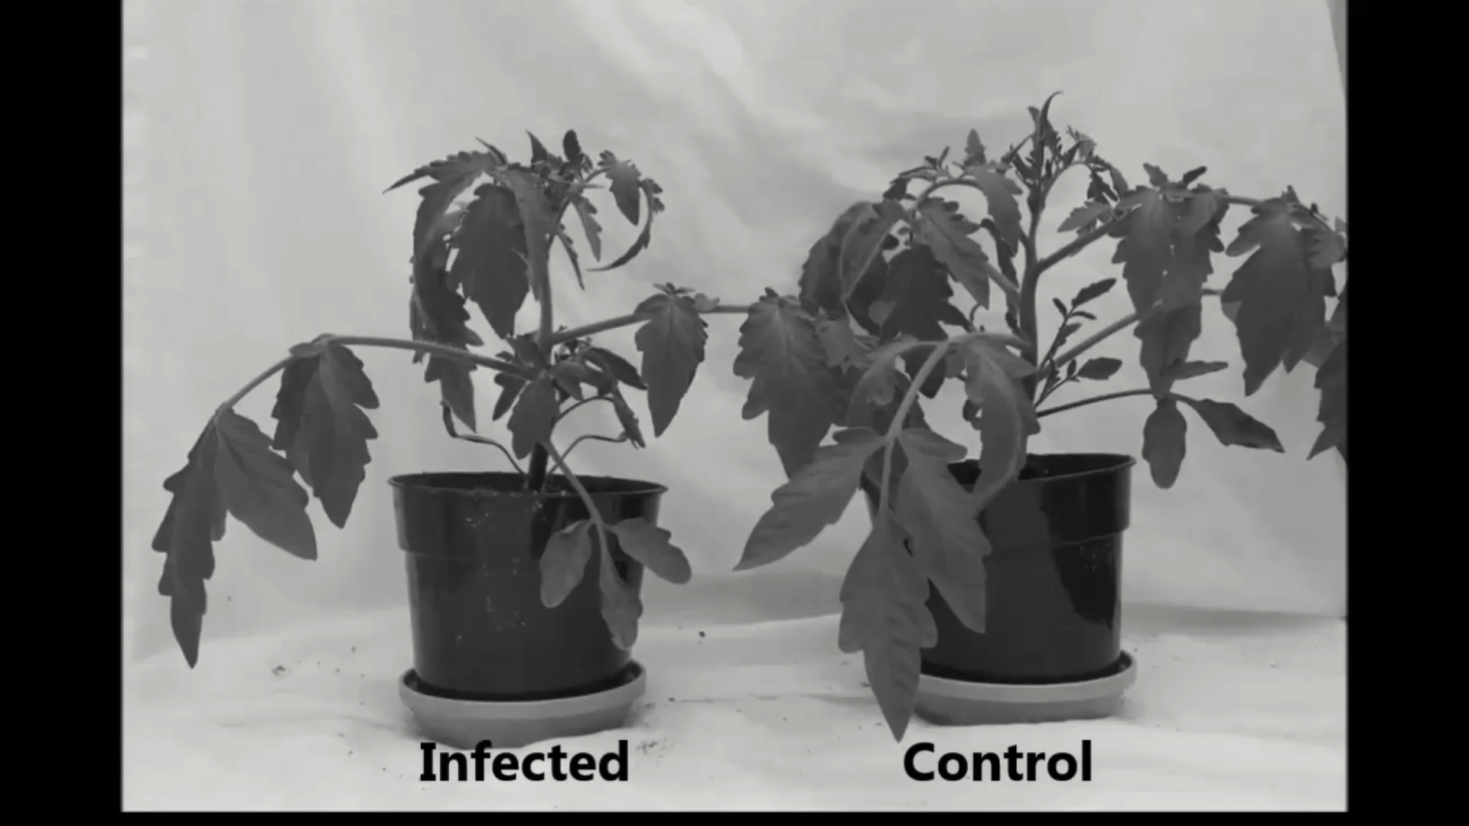
Ralstonia solanacearum species complex
While we wait for class to start, reflect on this video.
What symptoms occur during Ralstonia infection?
Why do you think those symptoms occur?
+Ralstonia
Healthy
Time Lapse by Dr. Jon Jacobs (OSU) https://vimeo.com/74855449
Notes:
I appreciate the opportunity to teach a case study about a bacterial plant pathogen that is dear to my heart, Ralstonia. I consider myself a microbiologist, plant pathologist, molecular biologist, and microbial ecologist, so those disciplines influence the material that I think is important to teach you today.

Slide 2
Ralstonia’s Evolutionary neighborhood
Genus
Class
Phylum
Caulobacter
Alpha (α)
Agrobacterium
Neisseria
Ralstonia
Burkholderia
Salmonella
Gamma (γ)
Escherichia
Pseudomonas
Xanthomonas
Xylella
Clostridium
Firmicutes
Gram
Positives
Bacillus
Streptomyces
Actinobacteria
Notes:
I always like to know the evolutionary neighborhood of microbes. Ralstonia is a gram-negative beta-proteobacteria rod. It’s a cousin to Burkholderia which is becoming an emerging infectious disease of humans.

Slide 3
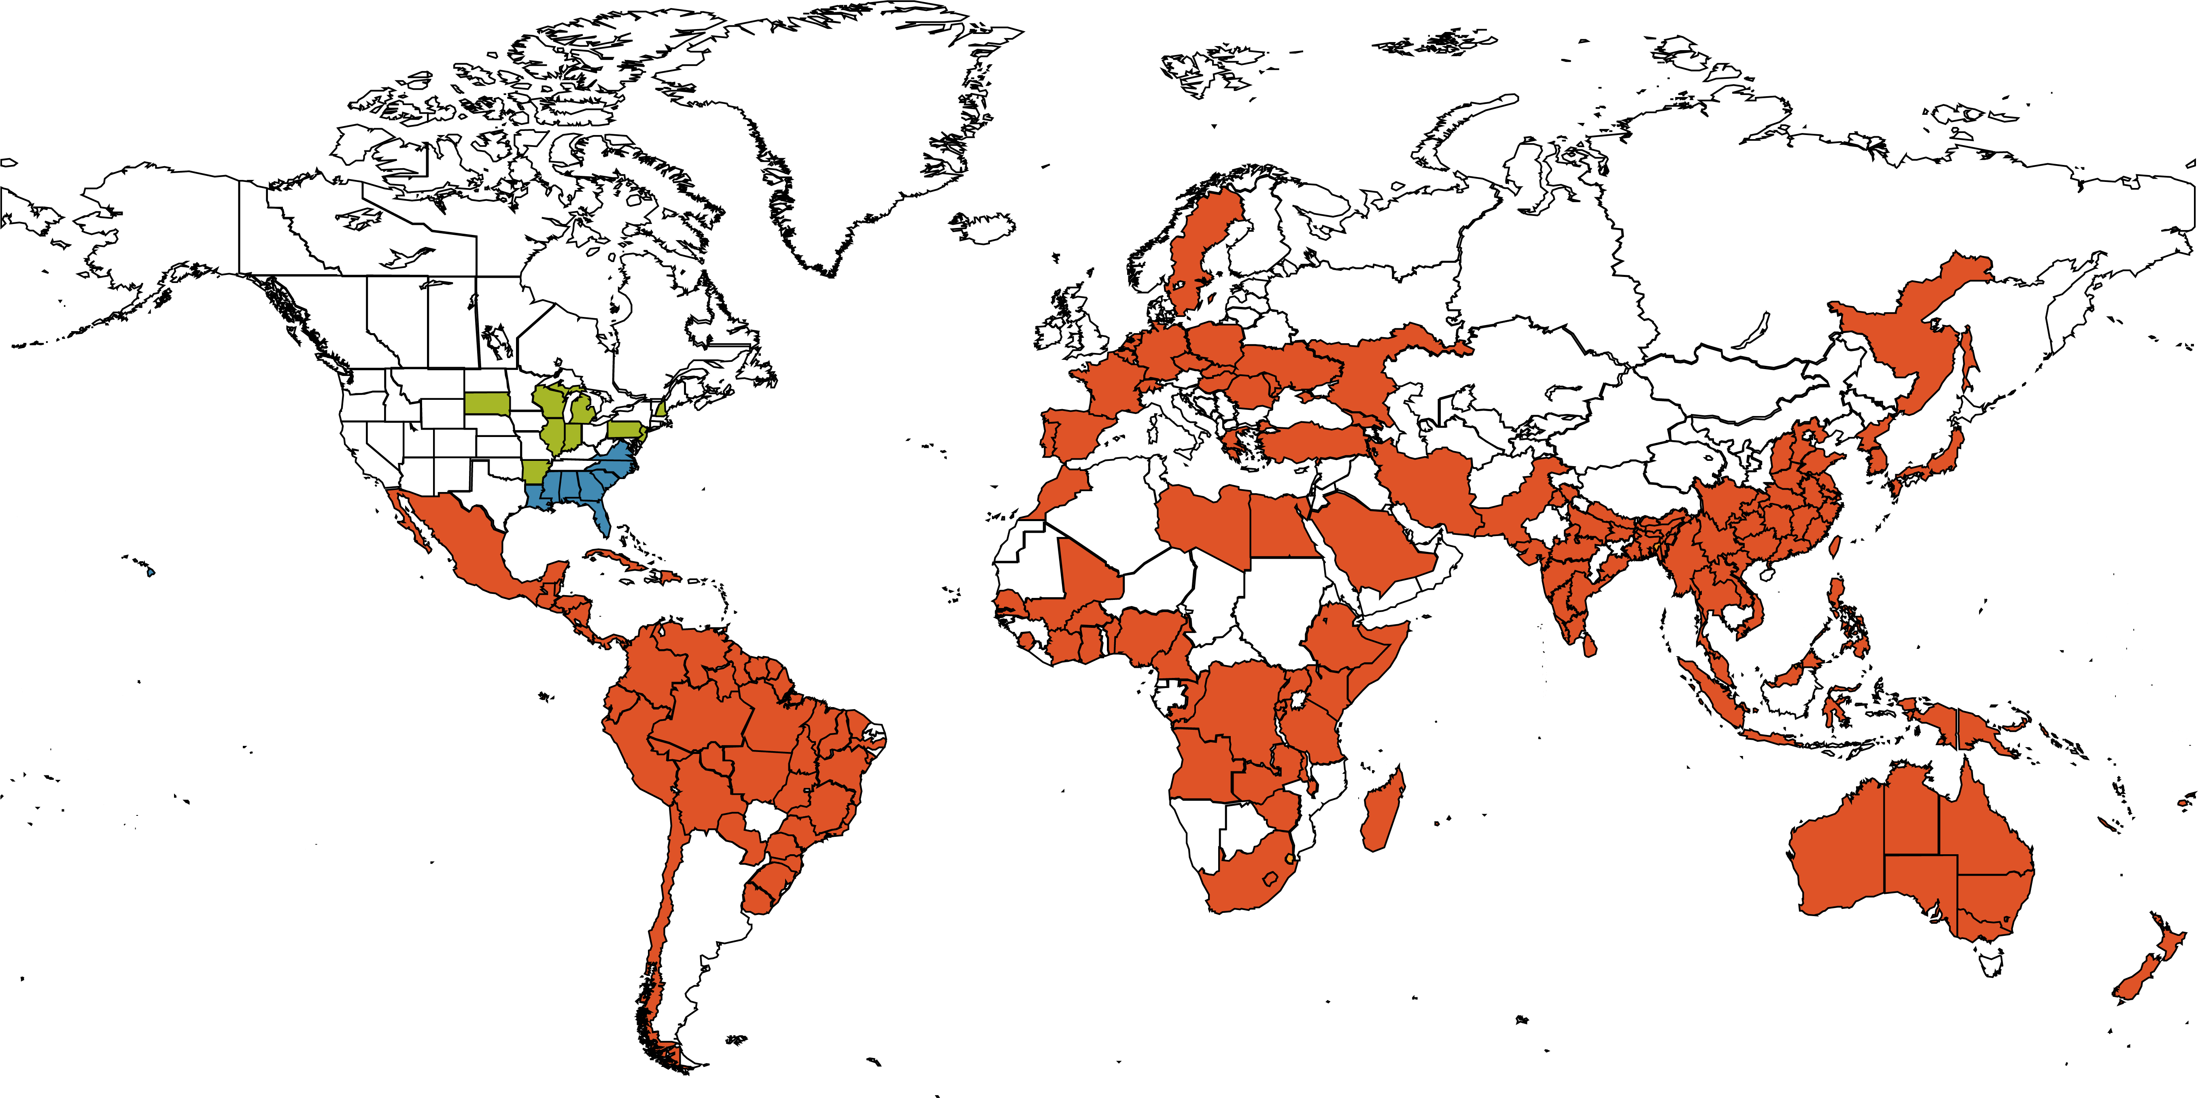
Ralstonia and Bacterial Wilt Disease
~Locations with published reports of RSSC wilt
Notes:
We are focusing on Ralstonia solancearum, which causes bacterial wilt disease. Plant diseases are very linked to environmental conditions for several reasons. One – plants are not warm blooded, so microbes must be able to grow or survive the weather. Second, plants are stationary in the environment. So pathogens must be able to survive their environment to transmit between plants.
Ralstonia survives in regions with warm weather and yearround precipitation, where soil moisture is high. This map shows locations where Ralstonia has been reported in the EPPO database.

Slide 4
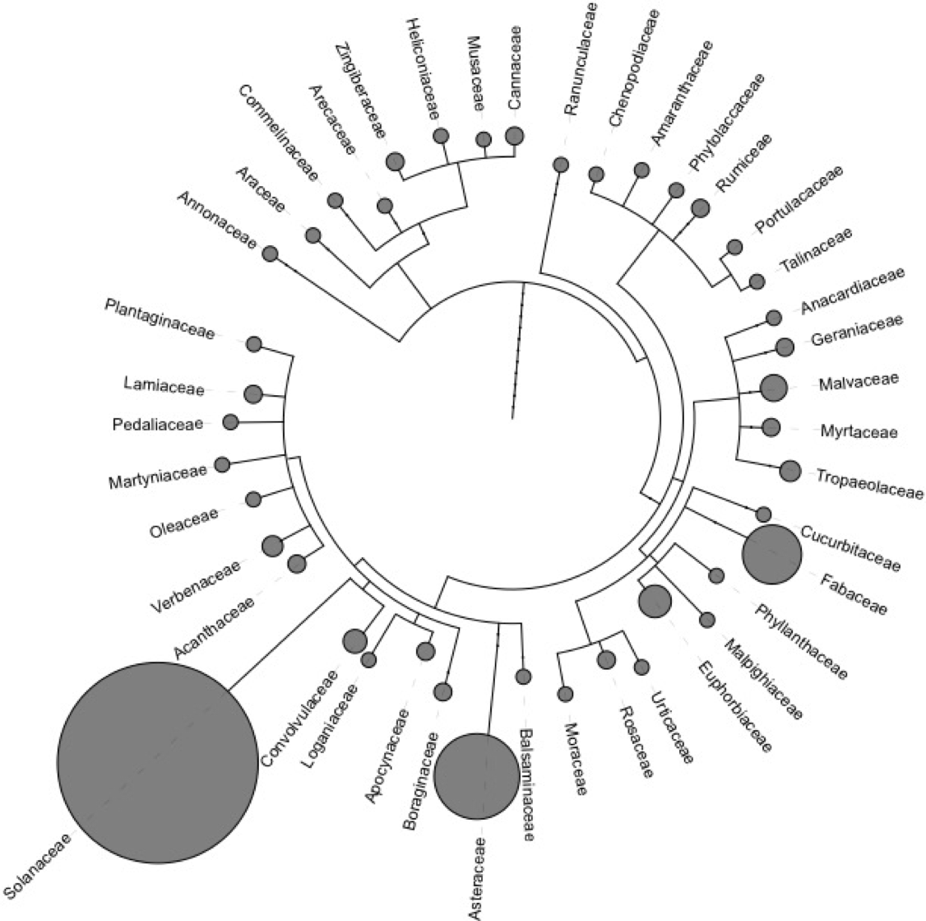
RSSC Host Range
Notes:
The species complex infects over 200 plant species, including several crops.
Tomato is susceptible to most strains. Tomato and potato are in the Solanaceae family, which is where the “solanacearum” comes from for this species.
Potato is a very important crop around the world because it is one of the more nutritionally complete vegetables, containing essential vitamins and amino acids. Unfortunately, a pandemic strain of Ralstonia is spread through seed potatoes to most potato growing regions. This potato is actually infected with Ralstonia – the xylem vessels are full of white bacterial goo and the surrounding tissue is browned from rot.
Banana is also an important crop that Ralstonia infects in South America and Indonesia/SE asia, but not in Africa (yet). Cavendish dessert bananas are a cash crop, and many other starchy and dessert bananas are staple foods in tropical areas.

Slide 5
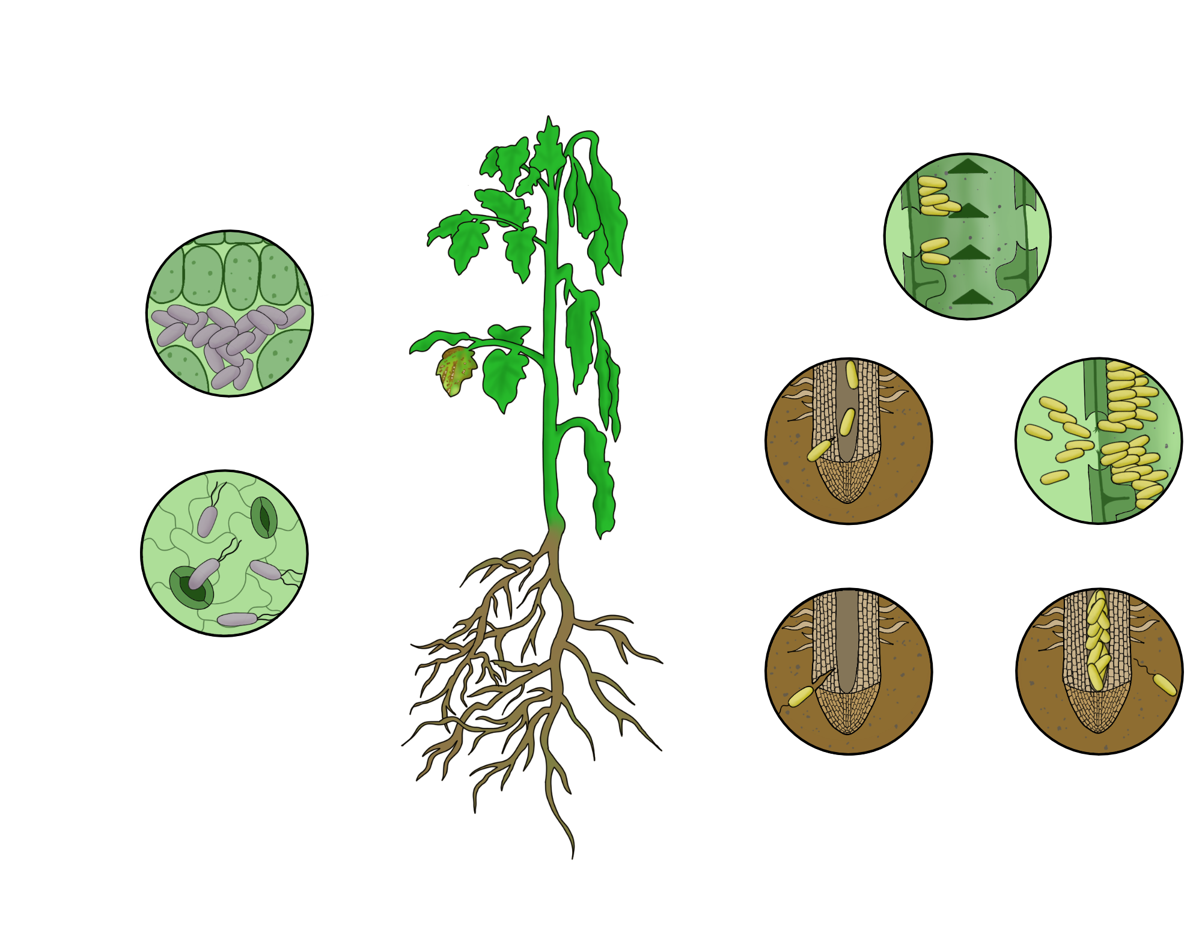
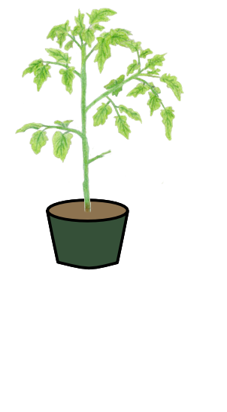

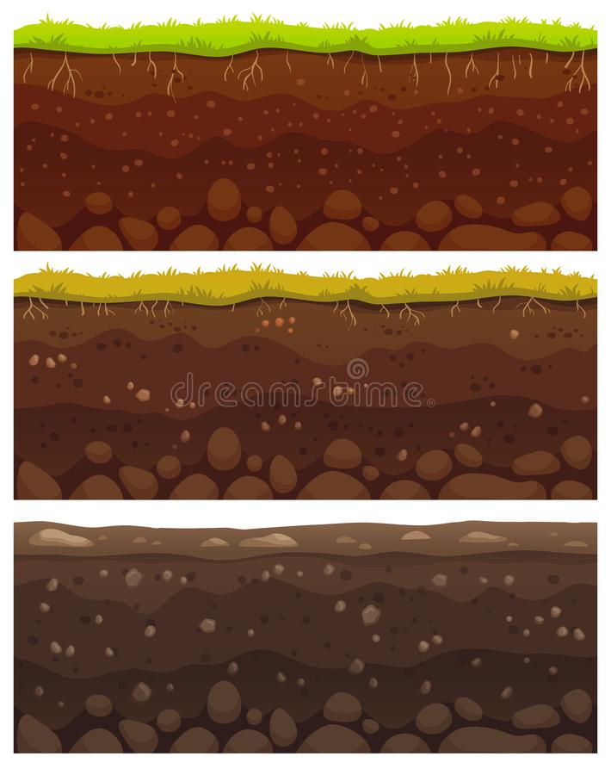
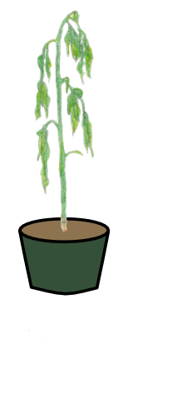
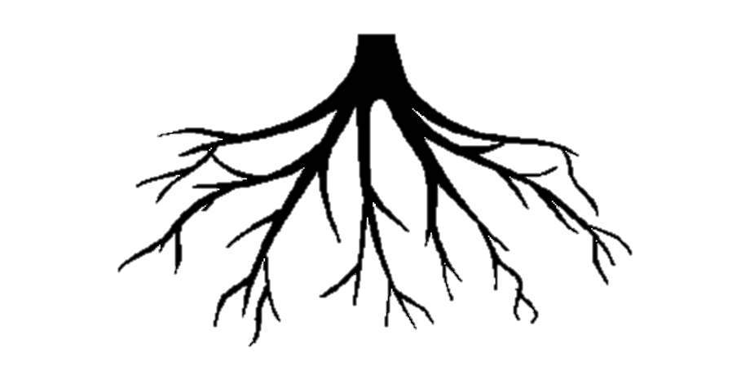
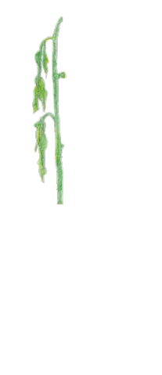
Life Cycle
Notes:
Ralstonia are soil-borne pathogens. They colonize plant roots, then invade the xylem vessels that transport water, leading to a systemic infection. The clog and damage the xylem, which leads to the wilt symptoms. During infection, they shed from roots where irrigation or rain water can wash them to new plants.
Local transmission of Ralstonia is predominantly through the movement of surface water.
Ralstonia does not survive dessication well. So long distance movement of Ralstonia is mostly due to human activity by movement of latently infected plants. People tend not to move symptomatic plants. Both potatoes and bananas are propagated clonally, which makes them very susceptible to moving diseases.

Slide 6
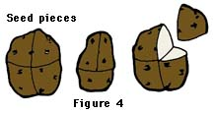
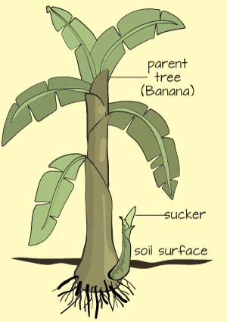




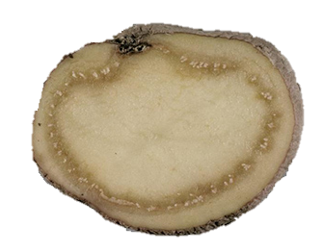
Transmission modes
Notes:
Ralstonia are soil-borne pathogens. They colonize plant roots, then invade the xylem vessels that transport water, leading to a systemic infection. The clog and damage the xylem, which leads to the wilt symptoms. During infection, they shed from roots where irrigation or rain water can wash them to new plants.
Local transmission of Ralstonia is predominantly through the movement of surface water.
Ralstonia does not survive dessication well. So long distance movement of Ralstonia is mostly due to human activity by movement of latently infected plants. People tend not to move symptomatic plants. Both potatoes and bananas are propagated clonally, which makes them very susceptible to moving diseases.

Slide 7
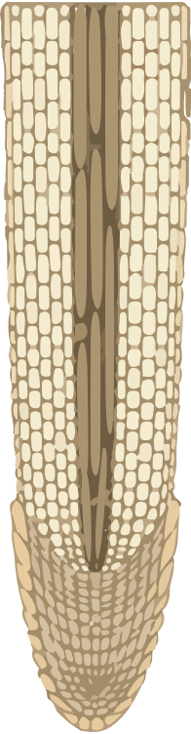
Root Colonization Traits
Trait | Why is this trait adaptive in this niche?
Phosphorylation
cascade
P
Flagellum
Response Regulator
Notes:
Now we’re getting into the meat and potatoes. How does Ralstonia complete it’s life cycle?
First, Ralstonia must find plant roots and invade them. It uses chemotaxis to sense the chemicals that roots exude, which regulates activity of its flagella so that it swims towards roots with the run and tumble mechanism.

Slide 8
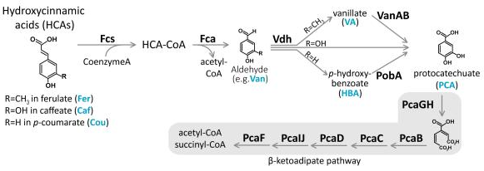
Root Colonization Traits
Trait | Why is this trait adaptive in this niche?
Notes:
Roots exude nutrients and other chemicals that have antimicrobial effects. Ralstonia has an enzymatic pathway that allows them to degrade and eat one common class of plant phenolic compounds, hydroxycinnamic acids, which have this structure. During my PhD, I found that this pathway helped Ralstonia colonize roots, but Ralstonia did not need this pathway at later disease stages.

Slide 9
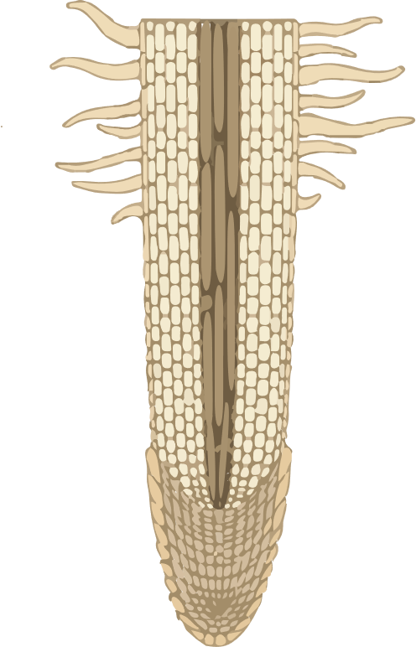
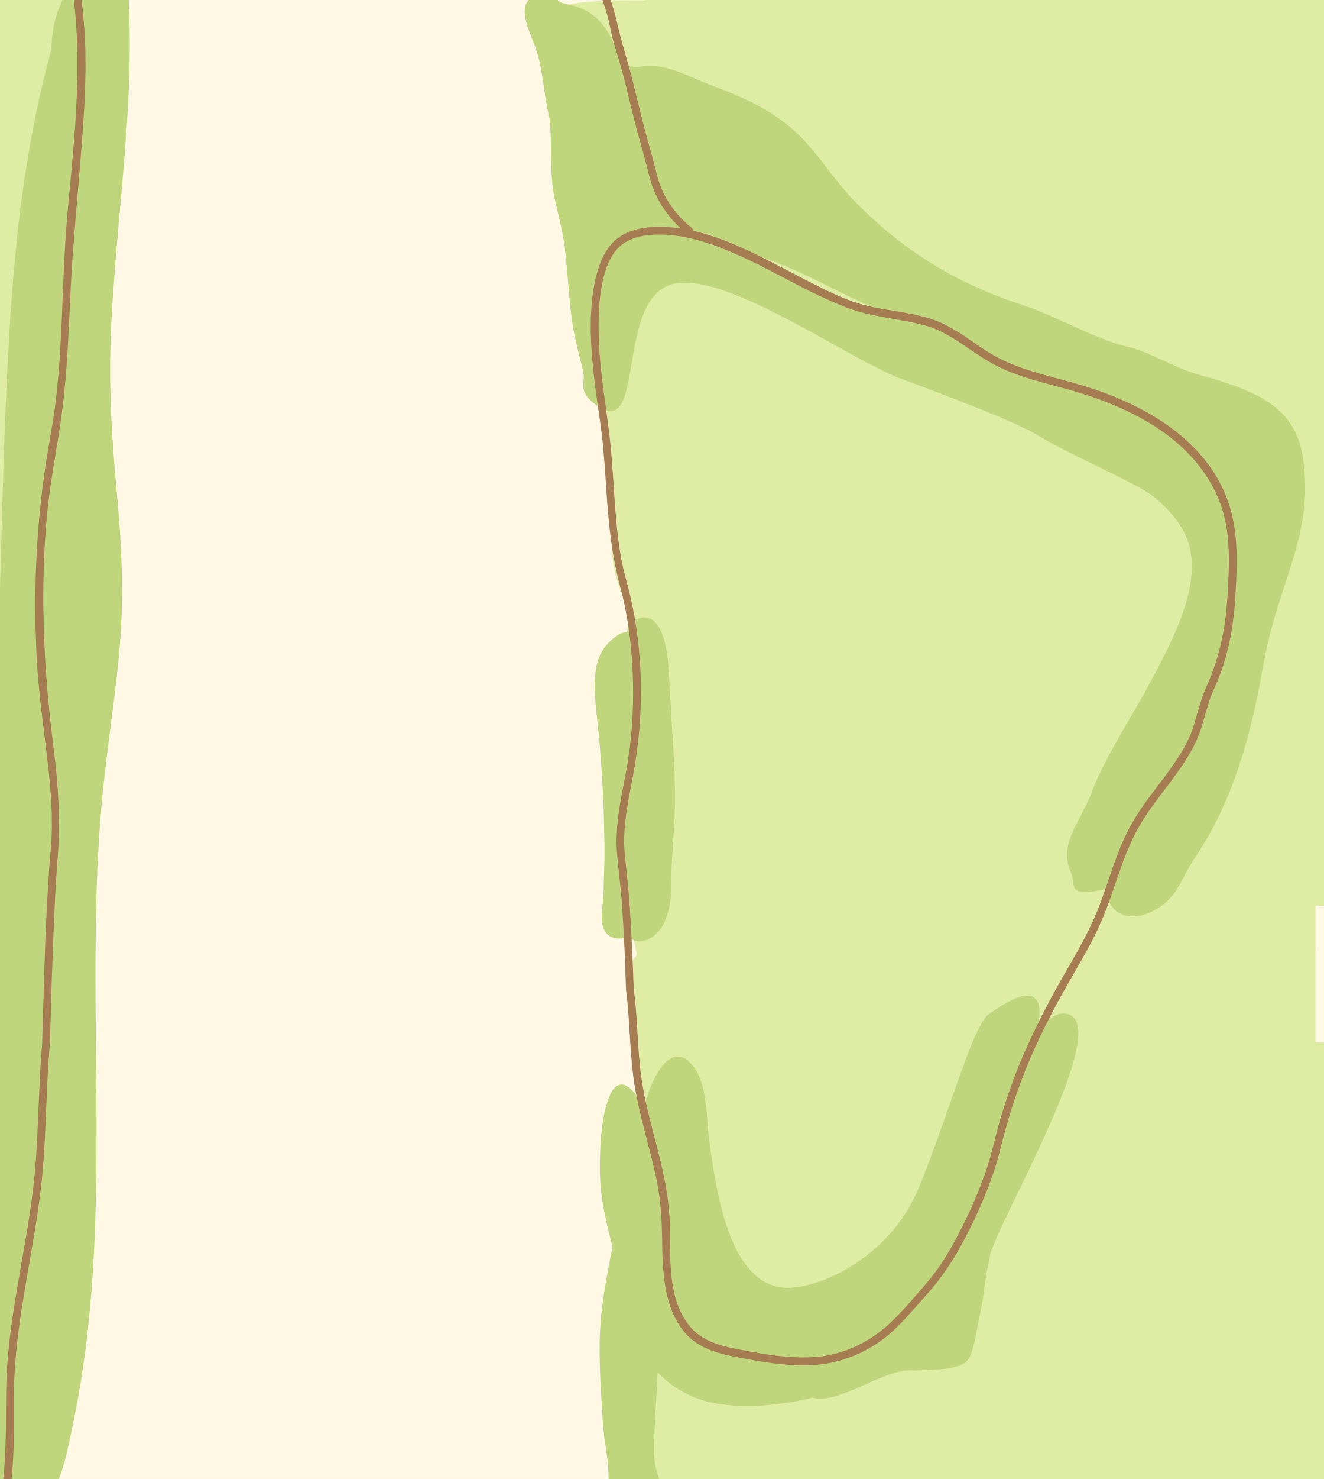

Xylem Colonization Traits
Trait | Why is this trait adaptive in this niche?
Notes:
Now we will move into the traits that help Ralstonia in planta. Quorum sensing is one of the most important traits because it allows Ralstonia to shift its behavior from a scavenger/survival state at low cell density to an aggressive pathogen state when in planta.

Slide 10
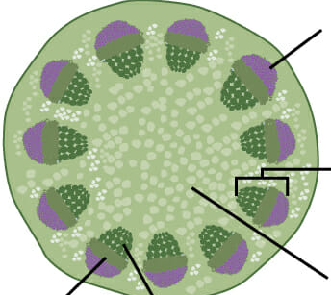
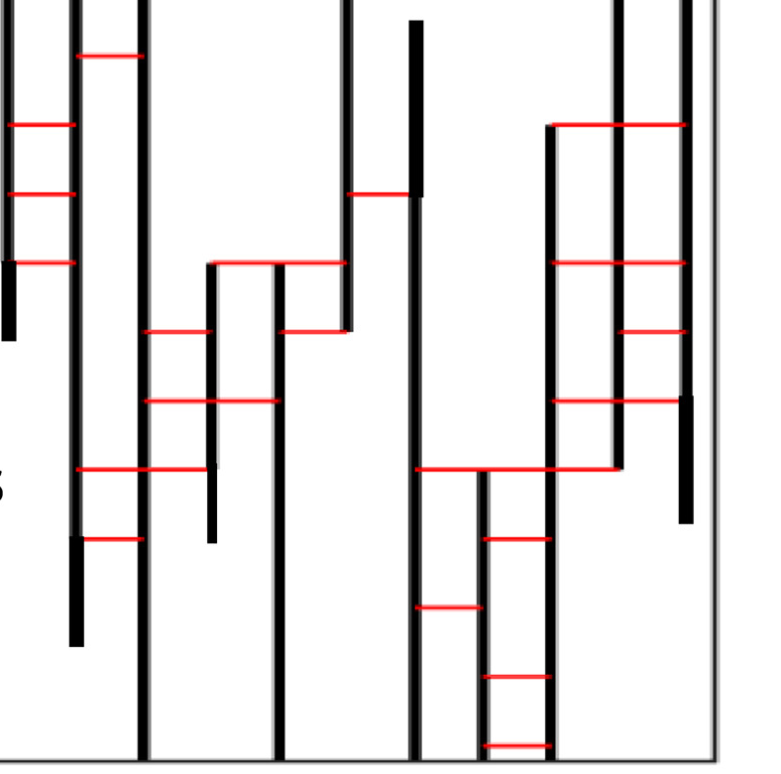
Xylem Colonization Traits
Trait | Why is this trait adaptive in this niche?
Notes:
Now we will move into the traits that help Ralstonia in planta. Quorum sensing is one of the most important traits because it allows Ralstonia to shift its behavior from a scavenger/survival state at low cell density to an aggressive pathogen state when in planta.

Slide 11
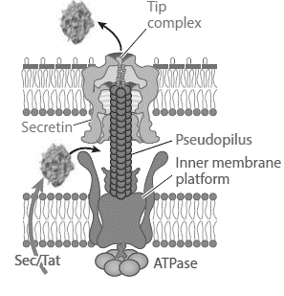







Xylem Colonization Traits
Trait | Why is this trait adaptive in this niche?
Notes:
Now we will move into the traits that help Ralstonia in planta. Quorum sensing is one of the most important traits because it allows Ralstonia to shift its behavior from a scavenger/survival state at low cell density to an aggressive pathogen state when in planta.

Slide 12
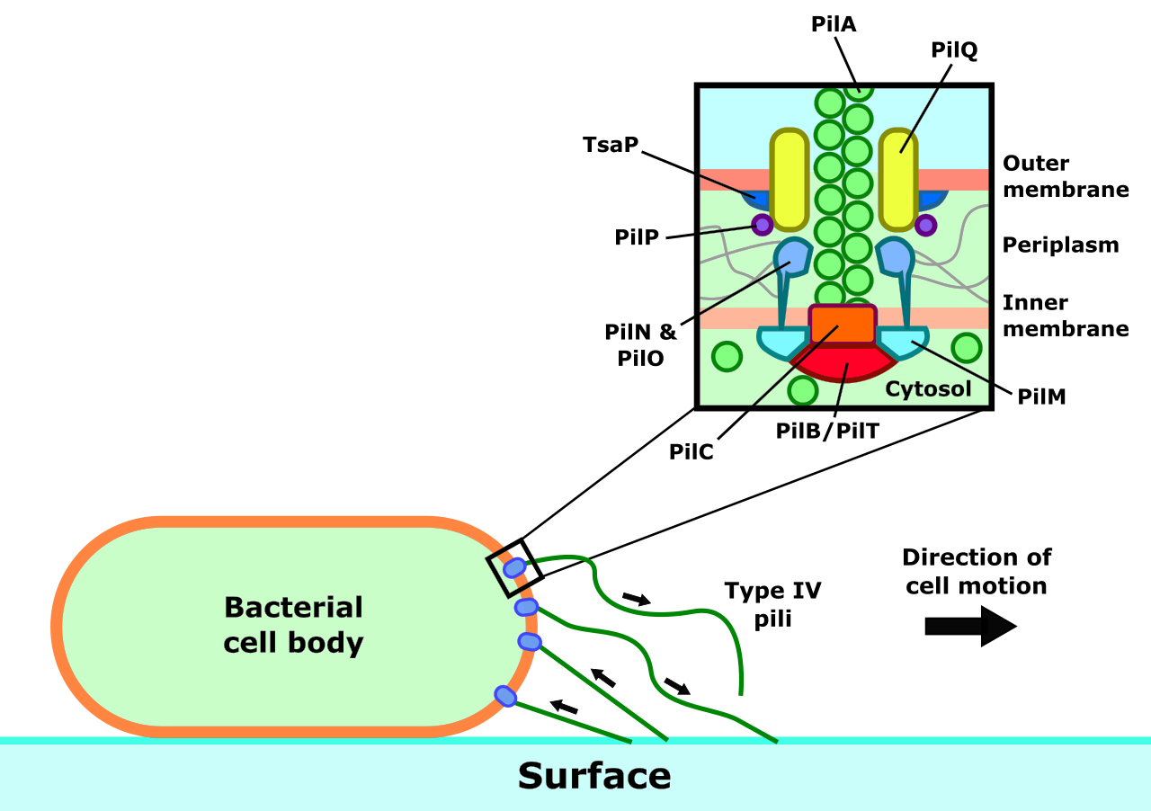
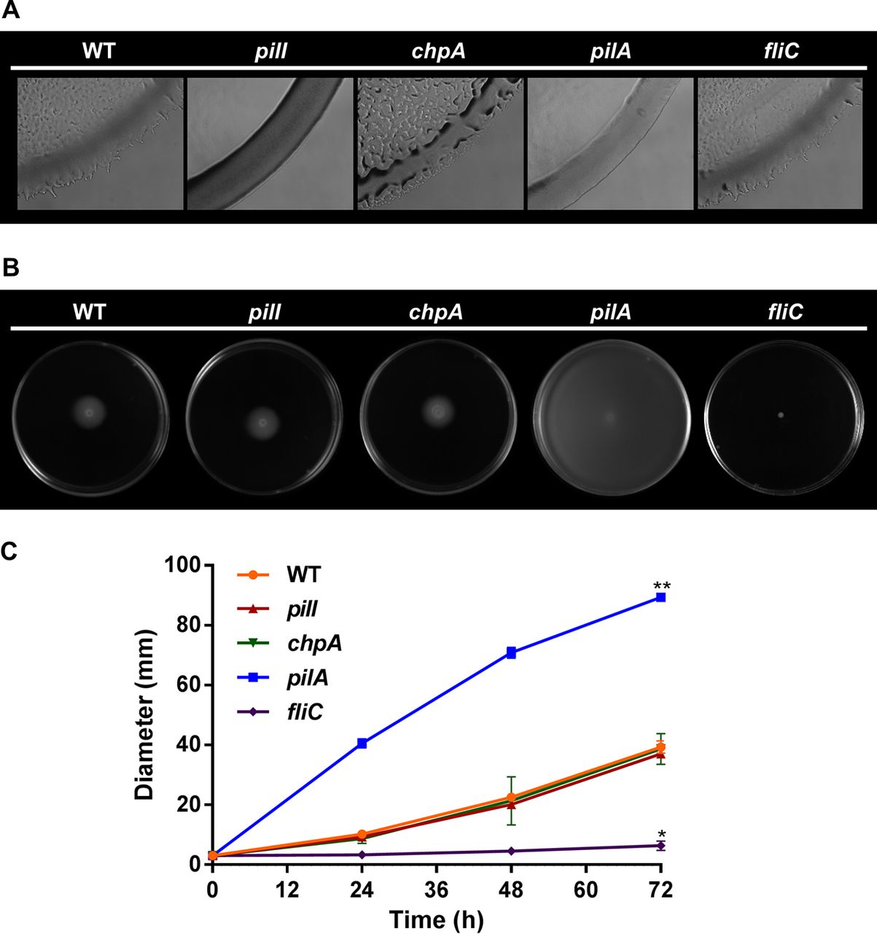
Xylem Colonization Traits
Trait | Why is this trait adaptive in this niche?
Notes:
Now we will move into the traits that help Ralstonia in planta. Quorum sensing is one of the most important traits because it allows Ralstonia to shift its behavior from a scavenger/survival state at low cell density to an aggressive pathogen state when in planta.

Slide 13
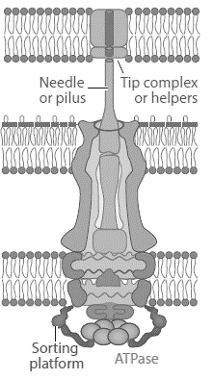







Xylem Colonization Traits
Trait | Why is this trait adaptive in this niche?
Notes:
Now we will move into the traits that help Ralstonia in planta. Quorum sensing is one of the most important traits because it allows Ralstonia to shift its behavior from a scavenger/survival state at low cell density to an aggressive pathogen state when in planta.

Slide 14

Xylem Colonization Traits
Trait | Why is this trait adaptive in this niche?
Notes:
Now we will move into the traits that help Ralstonia in planta. Quorum sensing is one of the most important traits because it allows Ralstonia to shift its behavior from a scavenger/survival state at low cell density to an aggressive pathogen state when in planta.

Slide 15
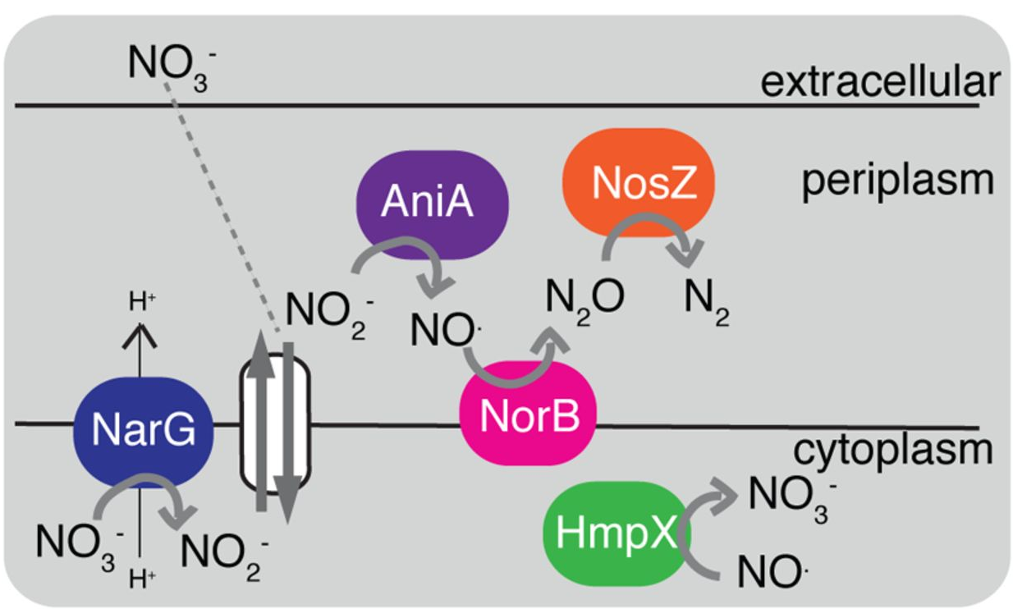
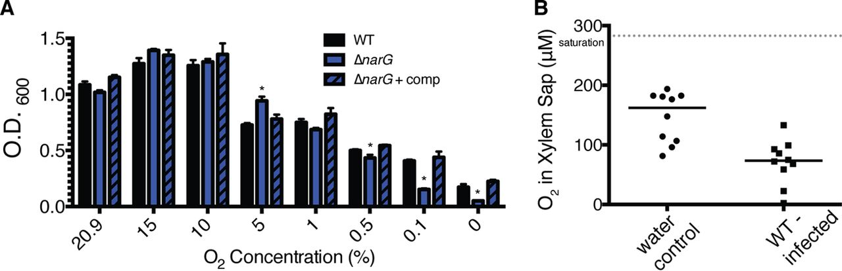
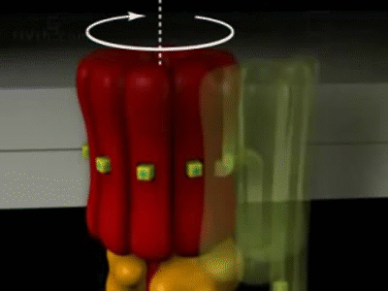
Xylem Colonization Traits
Trait | Why is this trait adaptive in this niche?
Notes:
Now we will move into the traits that help Ralstonia in planta. Quorum sensing is one of the most important traits because it allows Ralstonia to shift its behavior from a scavenger/survival state at low cell density to an aggressive pathogen state when in planta.

Slide 16
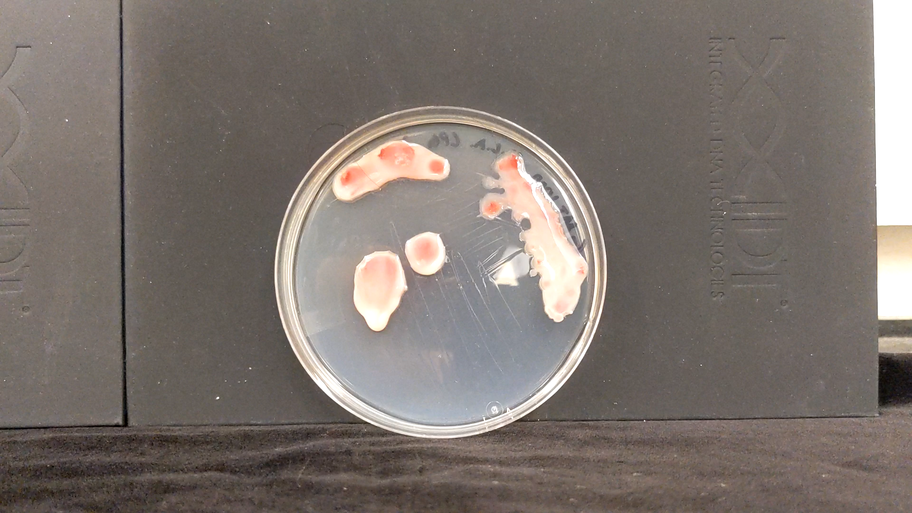
Xylem Colonization Traits
Trait | Why is this trait adaptive in this niche?
Notes:
Now we will move into the traits that help Ralstonia in planta. Quorum sensing is one of the most important traits because it allows Ralstonia to shift its behavior from a scavenger/survival state at low cell density to an aggressive pathogen state when in planta.

Slide 17
Xylem Colonization Traits
Trait | Why is this trait adaptive in this niche?

Slide 18
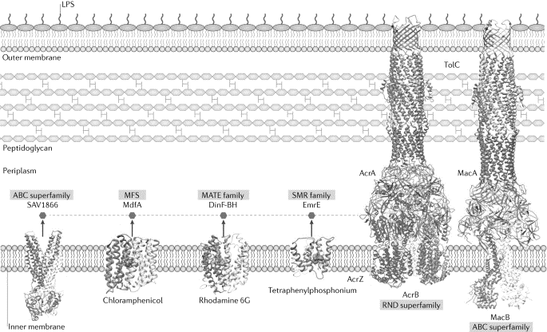
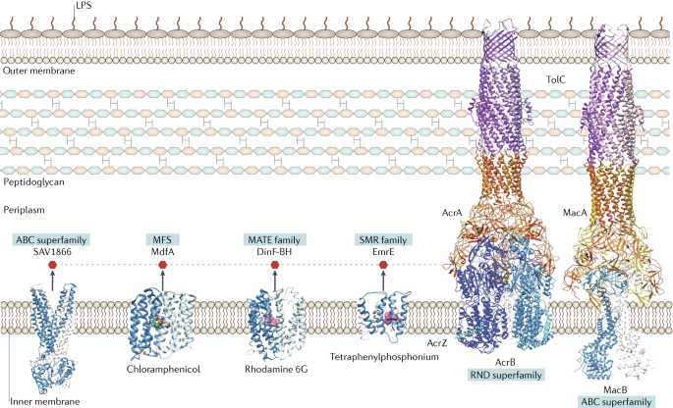










Xylem Colonization Traits
Trait | Why is this trait adaptive in this niche?
Notes:
Now we will move into the traits that help Ralstonia in planta. Quorum sensing is one of the most important traits because it allows Ralstonia to shift its behavior from a scavenger/survival state at low cell density to an aggressive pathogen state when in planta.

Slide 19
Environmental survival traits
Little is known!
The Lowe-Power lab is investigating traits that allow RSSC to:
Notes:
Format: I designed today’s lecture to provide an overview of one bacterial group and the traits that promote its fitness, virulence, and pathogenic success in planta. In the trait section, I would like you to take notes to answer “why does each trait help Ralstonia” If you guys have questions, put them in the chat. I’ll ask your TA Dani to answer the ones that she can since she’s an expert in a similar bacteria.

Slide 20
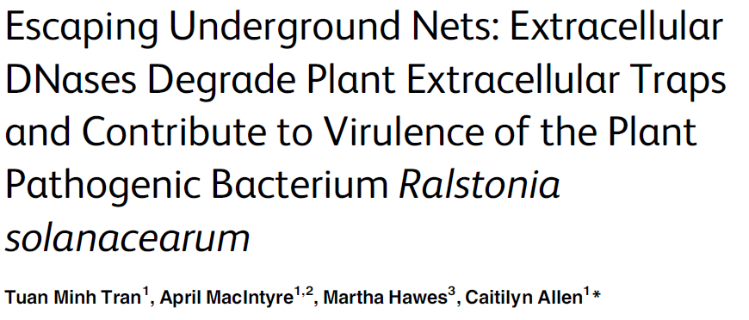
Please read the paper’s title.
Is any jargon unclear?
What will we learn about from this paper?

Slide 21
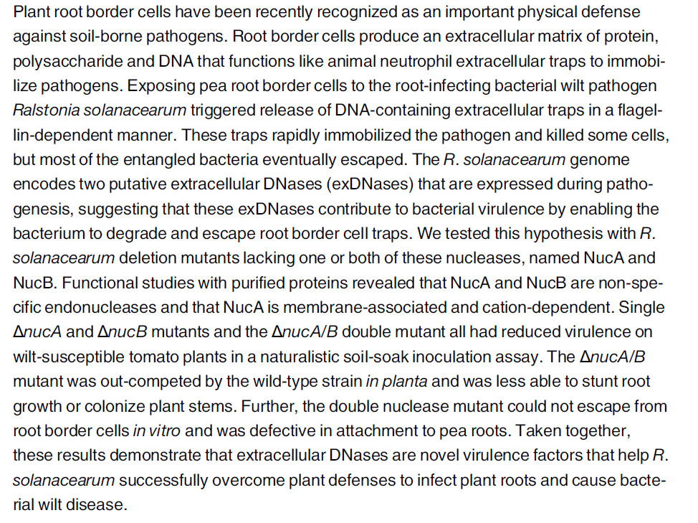
Please read the Abstract.
Is any jargon unclear?
What will we learn about from this paper?

